Slide 1



TAMIL POLITICAL TEXT EMOTION RECOGNITION
HARISH .M & JYOTHSNA .V
BY GROUP 3

Slide 2


PROBLEM STATEMENT
Tamil, being a low-resource language, presents unique challenges such as linguistic nuances, dialectical variations, and a scarcity of annotated data.
Existing emotion recognition models are largely trained on English and other widely spoken languages, with limited support for Tamil.
PROPOSED SOLUTION
Develop an Emotion Identification model capable of classifying emotions into one of seven distinct categories, by utilizing appropriate NLP tools to process Tamil texts, extract meaningful insights, and accurately determine sentiment.

Slide 3


APPLICATIONS OF SENTIMENT ANALYSIS
Political Analysis: Sentiment analysis helps political leaders and parties understand public opinion, improve campaign strategies, and respond to citizens' concerns in real time.
Business Intelligence: Companies use sentiment analysis to analyze customer feedback, improve products/services, and enhance brand reputation management.
Social Media Monitoring: It’s widely used to track trends, public reactions, and emotional responses to events, news, or social movements across platforms like Twitter, Facebook, and YouTube.

Slide 4


ADVANTAGES
1. Real-Time Public Opinion Monitoring: It enables governments and political entities to gauge public reactions instantly, helping them adapt strategies or policies based on current sentiment trends.
2. Data-Driven Campaign Strategy: Political parties can craft targeted messages and prioritize issues that resonate most with the electorate, improving voter engagement and campaign effectiveness.
3. Understanding Regional Political Mood: Analyzing Tamil-language political content (news, speeches, social media) captures nuanced public sentiment specific to Tamil Nadu and other Tamil-speaking regions, offering insights that English-only models miss.
DISADVANTAGES
Linguistic and Dialectal Complexity: Tamil has many dialects, code-switching patterns, and colloquialisms that are hard to capture using standard NLP models. This can reduce accuracy, especially if the model is trained on limited or non-diverse data.
Example: A sentiment model might misinterpret sarcasm, slang, or rural dialects used in Tamil Nadu’s social media or political discussions.

Slide 5

LITERATURE REVIEW
1
2
A Review of Sentiment Analysis on Non-English Languages
The study highlights key challenges in sentiment analysis for non-English languages, including limited linguistic resources, datasets, and language models.
Advances in machine and deep learning, particularly multilingual embeddings and transfer learning, have significantly improved performance.
Sentiment Analysis on Arabic Facebook Comments
This research investigates sentiment classification for Arabic, addressing dialectal variations and complex morphology with deep learning techniques.
Preprocessing methods such as tokenization, stemming, and stop-word removal play a crucial role in enhancing classification accuracy.
3
4
Sentiment Analysis at Document Level for Telugu Multi-Domain Data
The study focuses on document-level sentiment classification in Telugu, demonstrating the superiority of deep learning over traditional methods.
Effective feature extraction and context-aware models are essential for improving domain adaptability in sentiment analysis.
Deep Learning-Based Analysis of Tamil Code-Mixed Text Using ULMFiT
This paper explores sentiment analysis of Tamil-English code-mixed data, leveraging pre-trained ULMFiT models for enhanced classification performance.
Spelling variations and syntactic inconsistencies in code-mixed text require specialized preprocessing techniques for accurate sentiment detection.

Slide 6

DATASET ANALYSIS
DATASET
OVERVIEW
The dataset consists a training set with 4,352 samples and a testing set with 544 samples, with uneven class distribution. (that may result in less accurate classification.)
CATEGORY
TYPES
🔴 Negative – Criticism or Disapproval.
✅ Positive – Approval or Agreement.
🔍Substantiated – Well-supported claims 💬 Opinionated – Strong personal views.
😏 Sarcastic – Irony or Mockery.
⚖ Neutral – Unbiased or Factual.
❓ None of the above

Slide 7
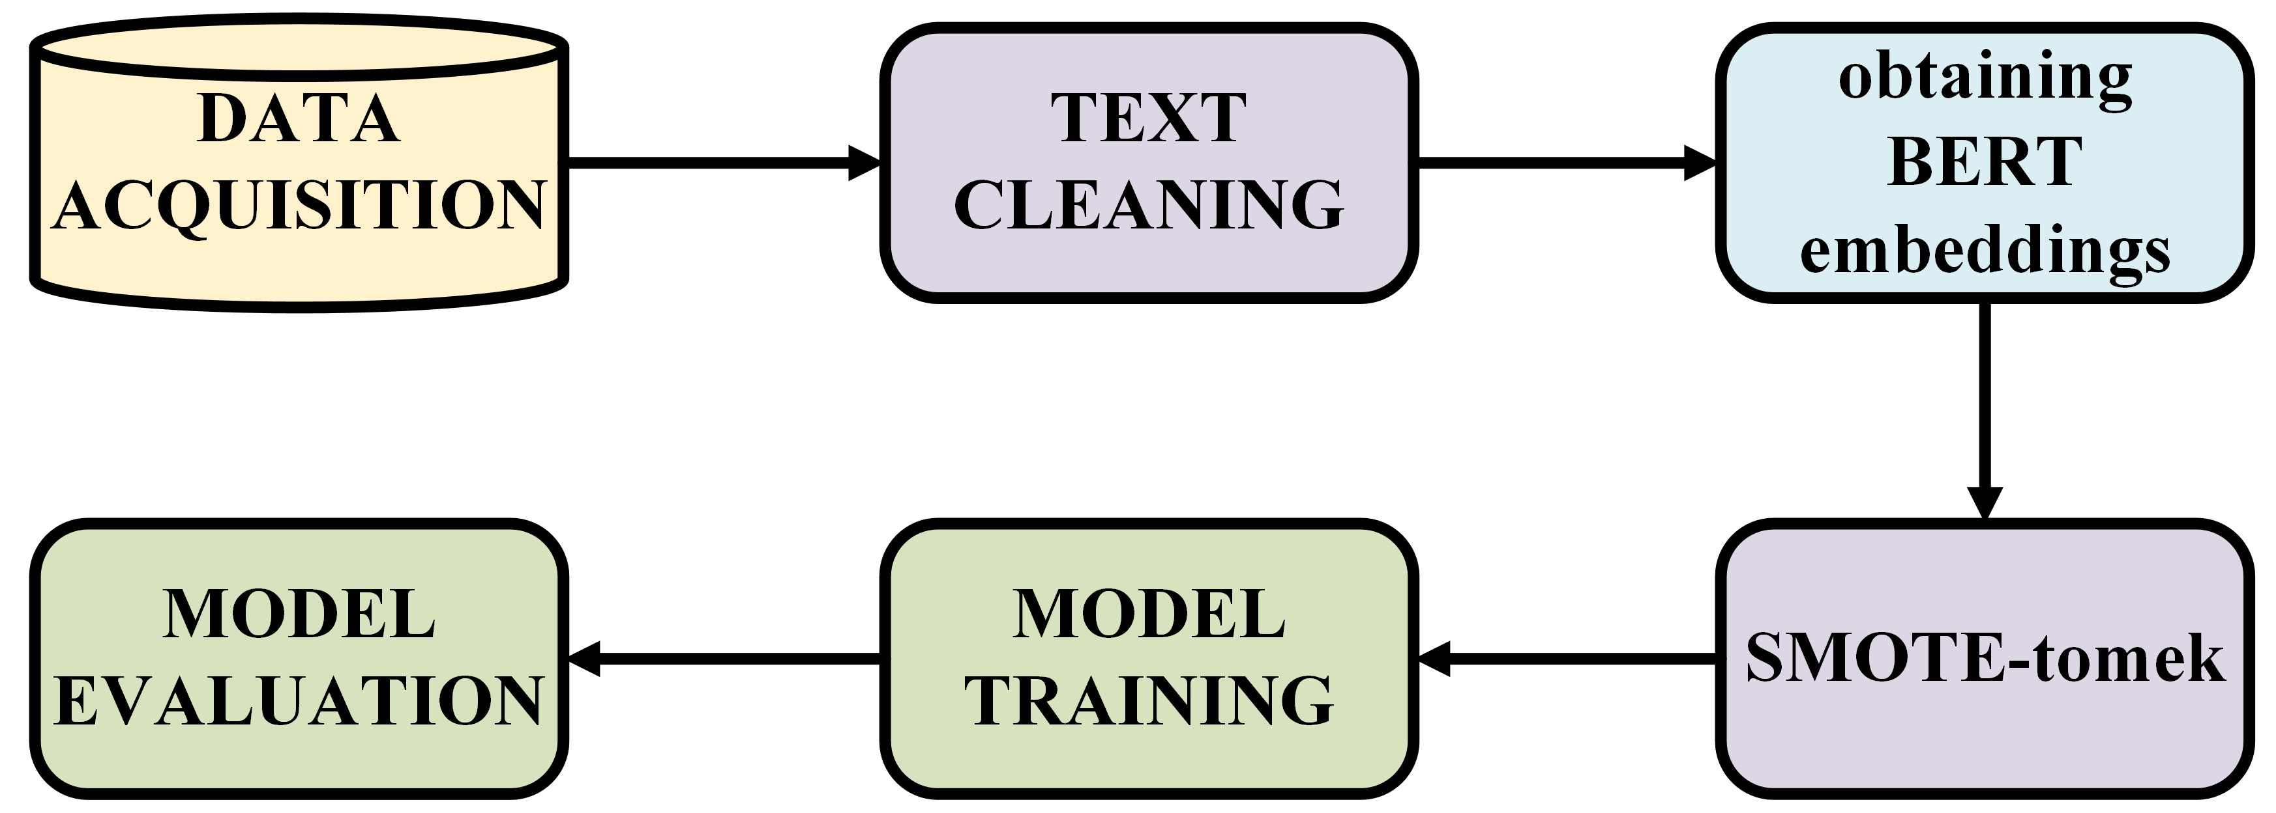
METHODOLOGY FLOWCHART

Slide 8
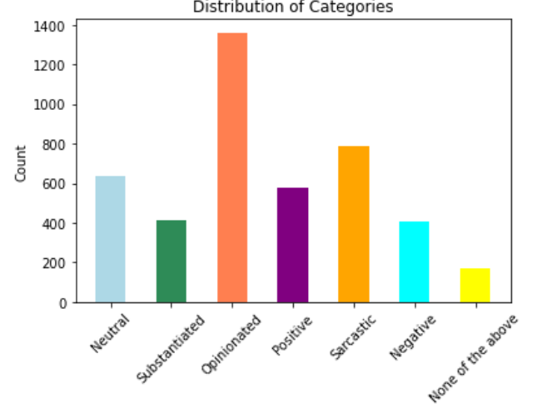
Handling Class Imbalance
Challenge: Imbalanced data leads to biased predictions.
Issues:
Overrepresented classes dominate.
Underrepresented classes might get low recall.
Model learns biased decision boundaries.
Solution (SMOTE-Tomek):
SMOTE generates synthetic samples for minority classes.
Tomek Links removes borderline samples to refine boundaries.
Outcome: Balanced data improves classifier performance, reduces bias, and enhances generalization across emotions.

Slide 9

BERT- Bidirectional Encoder Representations from Transformers
BERT (Bidirectional Encoder Representations from Transformers) is a machine learning model developed by Google for natural language processing (NLP) tasks.
It uses a transformer-based architecture to understand the context of words in a sentence by analysing them bidirectionally (both left and right).
BERT is pre-trained on large text corpora and can be fine-tuned for specific tasks like sentiment analysis, question answering, and text classification. Its bidirectional nature allows it to capture more nuanced language meanings compared to traditional models.

Slide 10
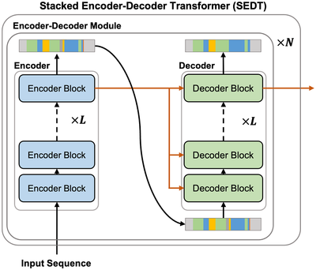
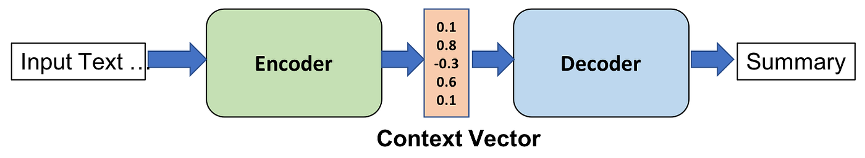
Why BERT?
Fig. A transformer model used for translation tasks
Transformer Encoder Layers: Uses self-attention and feedforward layers to process input bidirectionally, allowing the model to capture context from both past and future words.
In BERT, self-attention allows the model to weigh the importance of different words in a sentence to understand context, while feedforward layers process the attention-weighted representations to generate higher-level features

Slide 11
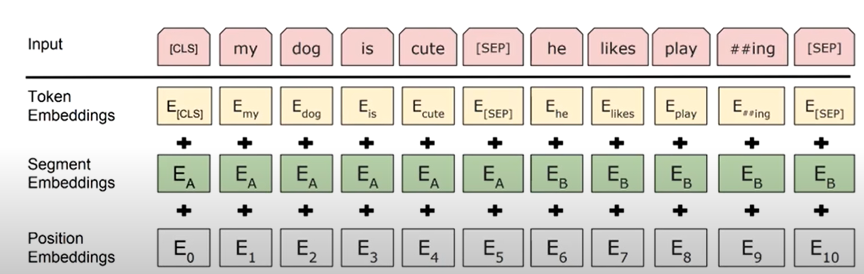

BERT Embeddings
Input Representation: Combines token embeddings, positional encodings, and segment embeddings:

Slide 12
PROJECT TIMELINE
Phase | Weeks | Key Tasks
Literature Review | Weeks 1-2 | Research & finalize methodology, consult with mentors.
Dataset overview, Feature Extraction and Analysis | Weeks 3-4 | Clean dataset, generate TF-IDF or BERT embeddings, or fuse embeddings.
Model Training & Fine-Tuning | Weeks 5 -15 | Train models, fine-tune and optimize hyperparameters, experiment with alternatives.
Experimental Insights Reporting | Week 15 - 20 | Generate and analyze metrics, create visualizations, document findings.

Slide 13
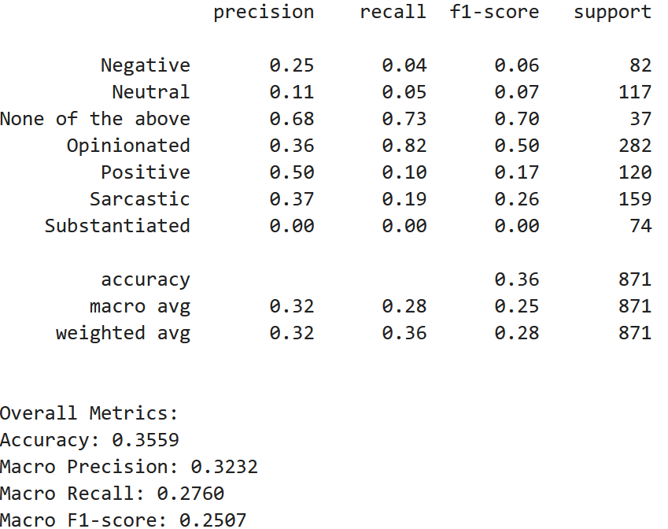
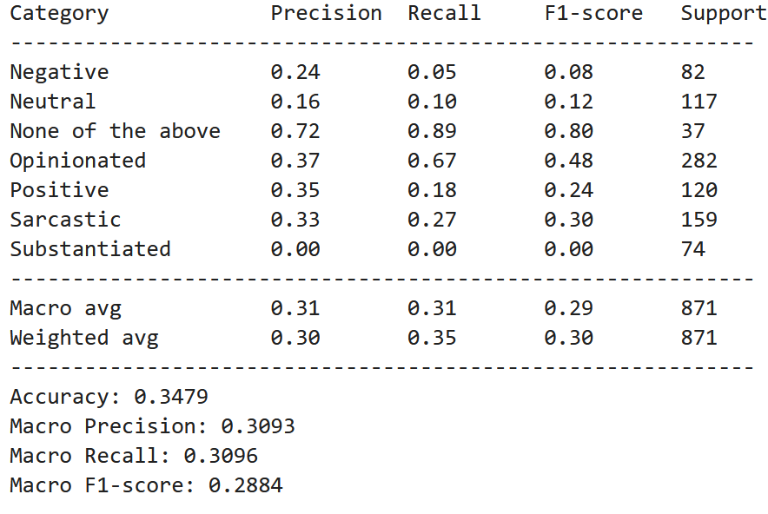
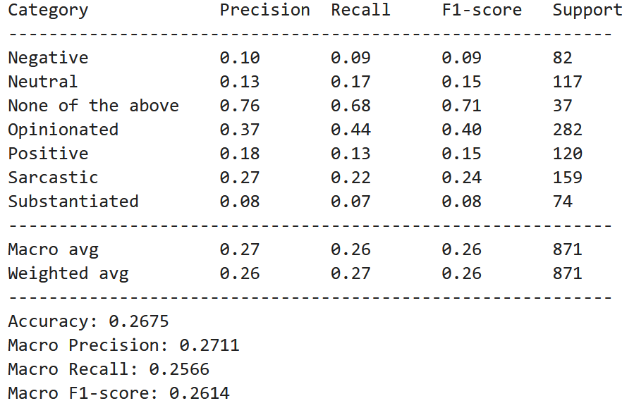

PHASE 1: Experimental Results & Understanding
XGBoost Classifier Performance Metrics
Random Forest Classifier Performance Metrics
SVM Classifier Performance Metrics
The sentiment analysis performed on the dataset, after translation to English, resulted in very low accuracy and F1-score, indicating that the chosen approach is ineffective.
Therefore, as part of our second approach, we will utilize m-BERT directly on the Tamil dataset to improve performance.

Slide 14
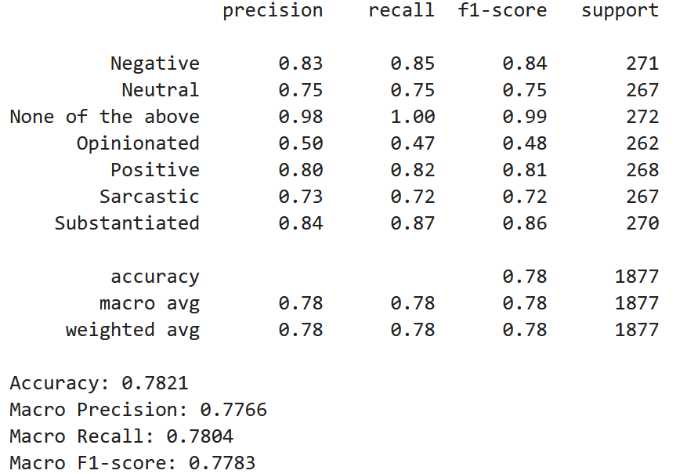
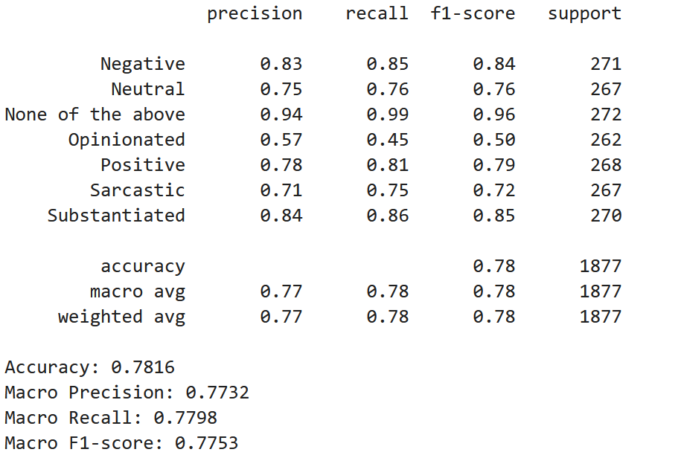
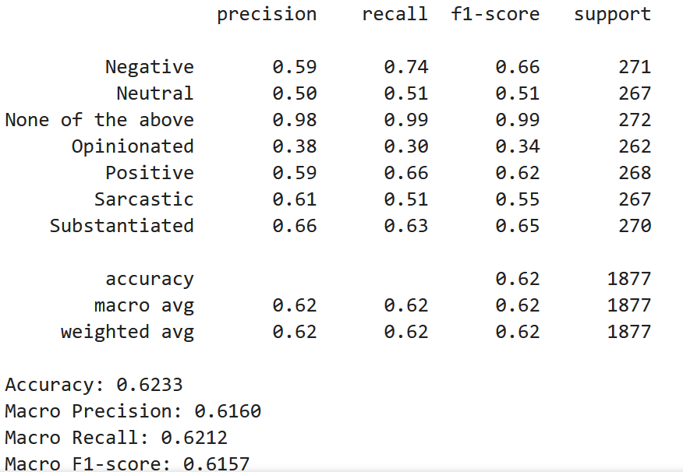
PHASE 2: Experimental Results
XGBoost Classifier Performance Metrics
Random Forest Classifier Performance Metrics
SVM Classifier Performance Metrics
After applying an 80-20 train-test split on the training data, the classifiers achieved the above accuracy.
However, when evaluated on the testing data, the model performed poorly, indicating overfitting.

Slide 15
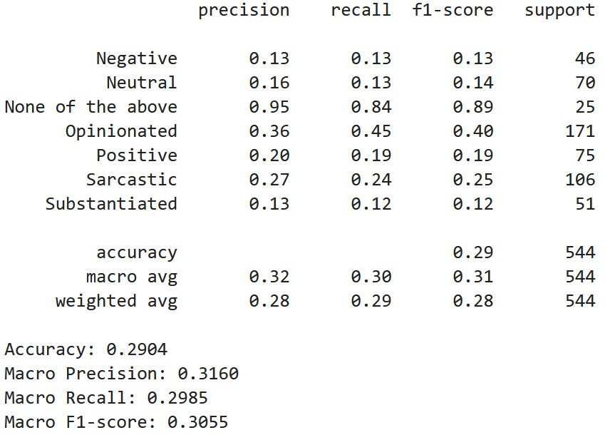
PHASE 2: Insights and Understanding
Challenge: Overfitting leads to poor generalization.
Issues:
• Model performs well on training data but poorly on unseen data. • Fails to generalize patterns, leading to inaccurate predictions on unseen data.
Solution:
• Lasso Regression (L1 Regularization) reduces model complexity by shrinking less important coefficients to zero. • Ridge Regression (L2 Regularization) penalizes large coefficients to prevent overfitting. • Logistic Regression with regularization helps control overfitting in classification tasks.
XG-Boost when evaluated with Separate Training data and testing datasets for Tamil language dataset

Slide 16
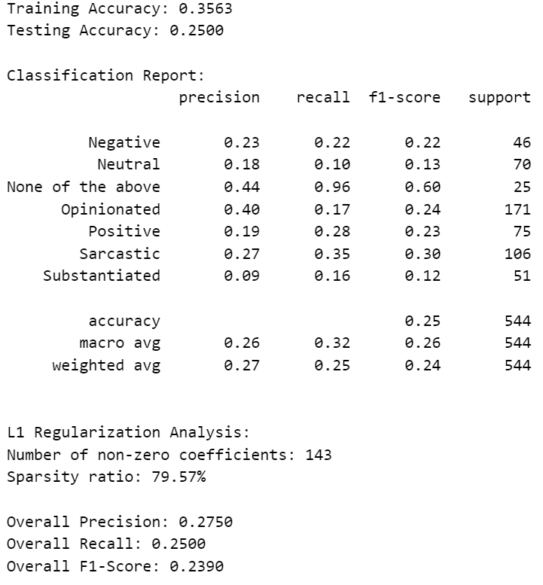
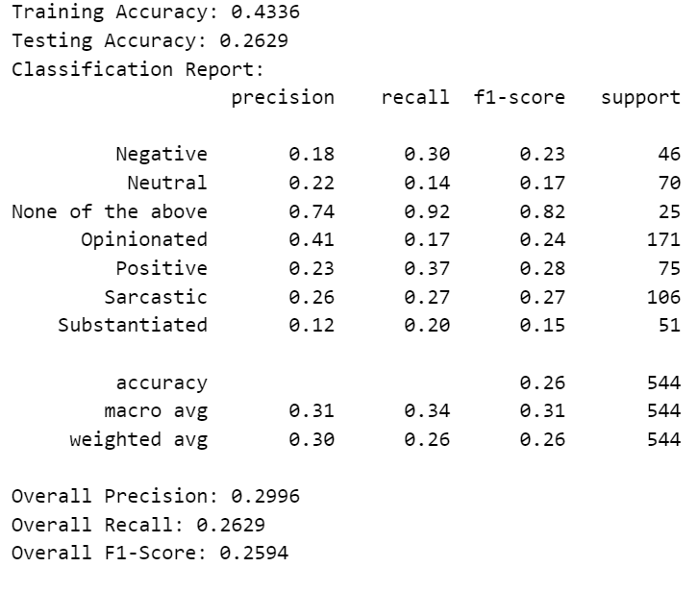
PHASE 3: Results and Future work
SVM + mbert + L1 regularization
SVM + mbert + L2 regularization

Slide 17

CHALLENGES FACED
🔹 Language Complexity – Tamil’s agglutinative nature and rich morphology make sentiment analysis challenging, requiring advanced linguistic handling. 🔹 Sarcasm & Context – Sarcasm, irony, and implicit sentiment in political discourse are difficult to detect without deep contextual understanding. 🔹 Class Imbalance – Uneven distribution of sentiment classes skews model predictions, requiring techniques like oversampling or balanced loss functions. 🔹 Translation Errors – Tamil-to-English translation may introduce semantic shifts, affecting the accuracy of sentiment classification. 🔹 Computational Cost – BERT-based models demand significant processing power.

Slide 18

CONCLUSION
In conclusion, developing an effective sentiment classification pipeline for Tamil text involves addressing a multifaceted set of challenges spanning linguistic complexity, data limitations, and computational constraints.
Data-related issues, such as class imbalance, necessitate careful handling through resampling strategies or balanced loss functions to ensure fair and accurate predictions.
Additionally, translation-based approaches introduce semantic drift that can compromise embedding quality, and high computational demands of transformer-based models limit their scalability.
These challenges highlight that conventional methods, even those successful in high-resource languages, do not directly transfer to low-resource, morphologically rich languages like Tamil

Slide 19
THANK YOU
BY GROUP 3

